Slide 1
Tour and Travelling Management System
Aditi Rajbongshi
ID : CSE 063 07 385
Nazmus Sakib
ID : CSE 057 06 986
Farzana Akhter
ID : CSE 063 07 425

Slide 2
Objectives
Construct interview questions for clients
Understanding the client and gather all the information what they actually want
Construct questionnaires for users
Summarized the survey results

Slide 3


Pattern of Information Gathering
We have chosen three methods for gathering information --
Interview
Questionnaires
Investigation

Slide 4
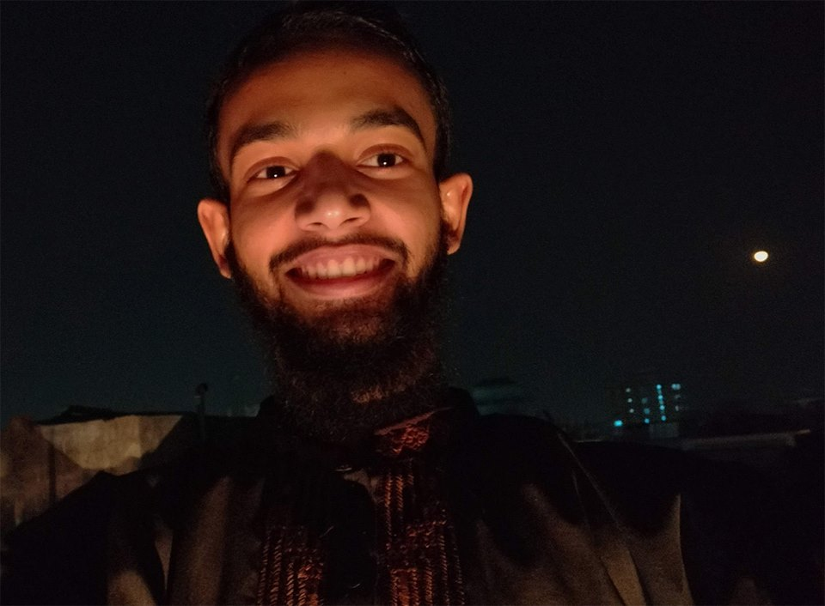
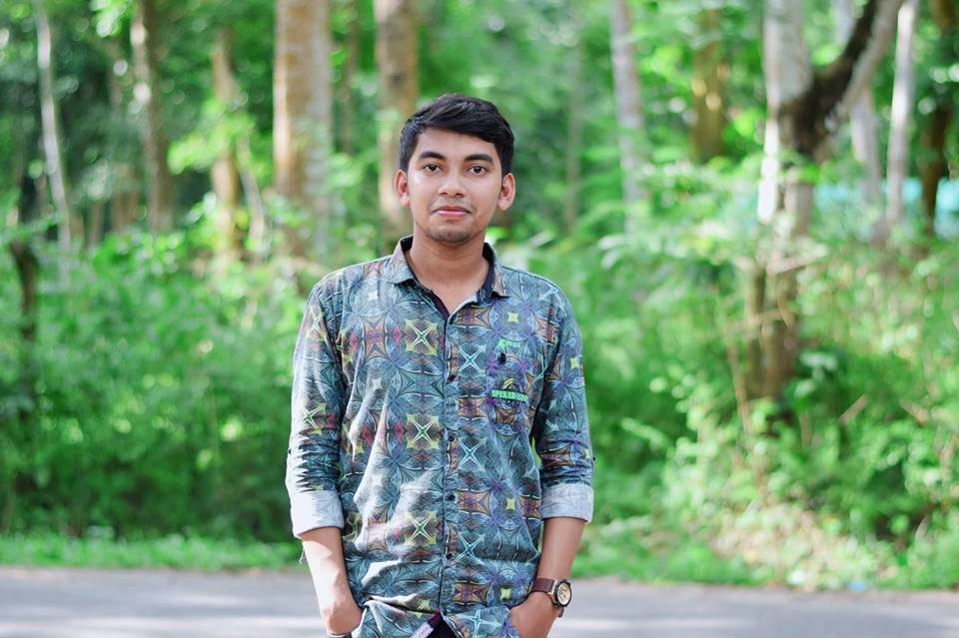
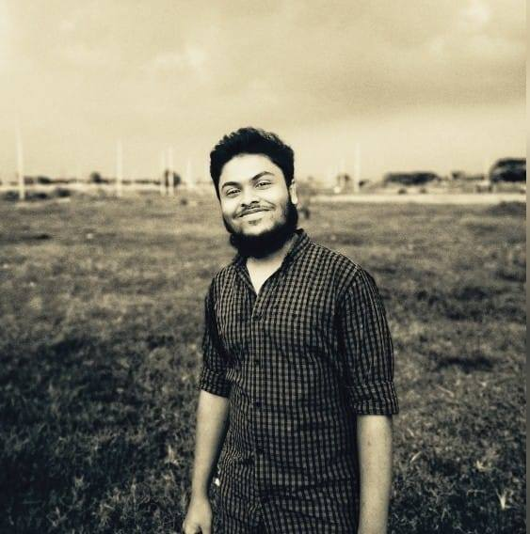
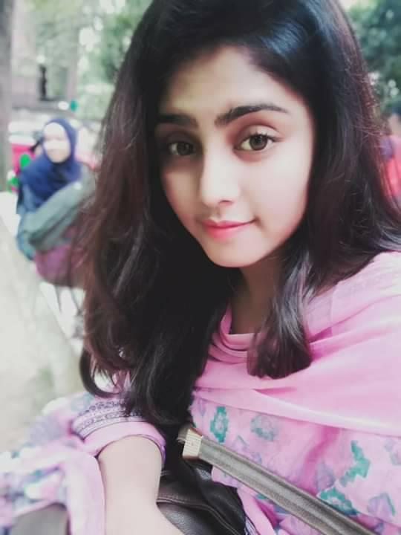
Selection of Interviewee
Interviewee : Team Diplomats
Abdullah Bashar Maruf
Noor Mohammed
Tanveer Rahat
Rahia Rono

Slide 5
Interview Question
1. Why do you need this new service?
Answer : Nearly everyone goes on a vacation. For this, tour and travel management system would play a vital role. I want to provide such a service where a single person can easily added to many other groups. It will save the customers tour cost if they get together and go to their desired destination. The system also helps to develop tourism with different cultures
So that they enrich the tourists experience.
2. What problem is this project going to solve?
Answer : When we make tour we face many kinds of problems such as manage hotel, vehicle, tour guide etc. We want to provide a services that automates the process and perform all operations related to travelling

Slide 6
Interview Question
3. What will happen if this project does not go ahead? How it will affect your business?
Answer : I think it will not affect my business in terms of failure. I want to run this system as my side business. Actually, this is an idea of mine which I want to implement as professionally.
4. What type of works is involved in travel and tourism industry?
Answer : As I told before, All types of travelling operations included medical support, money exchanging.

Slide 7
Interview Question
5. What challenges are you looking for in this service ?
Answer : We can see there are many number of travel agencies in the country, but we want to provide the premium quality services . Our platform would make tourism management easy by handling agencies requests and providing services for the customers located at different parts of the various cities.
6. Why do you want to work with us?
Answer : As we hear from many of friends about your company and your reputation of services. That’s why we have come.

Slide 8
Interview Question
7. What are you hoping will come at this project?
Answer : Actually, the main hope is to contribute in our tourism sector. There are many foreigner who come to see our beloved country. If we provide them a good service they must be give a satisfied rating to our country. Therefore, we want to represent our country to the world people. Also there must be a hope of earning money.
8. Do you have any budget range?
Answer : yes. For the first develop we want spend maximum 50,000 taka.

Slide 9
Interview Question
9. How will you measure the success?
Answer : More signups, more people in our mailing lists, customer feedback etc. all this are variable of measuring the success.
10. What concern you most about this project?
Answer : I love to go on a tour when I get time. I have visited many country with foreign travel agencies . But I have faced many difficulties when I go with local agencies. So, personally I feel concern to improve the quality of our country tourism management.
11. If this project could achieve only one goal, what would it be?
Answer : Of course, the goal is to earn money. As I want to implement this system professionally, my first goal would be money.

Slide 10

Questionnaires
Number of Question : 09
Question Type : Closed Ended

Slide 11
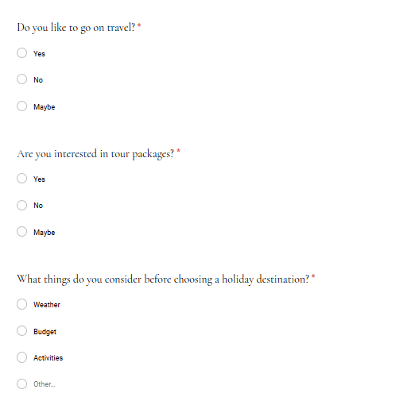
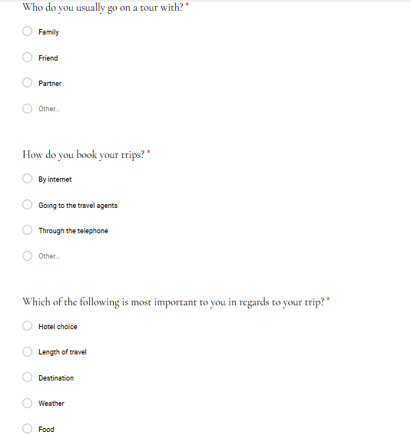
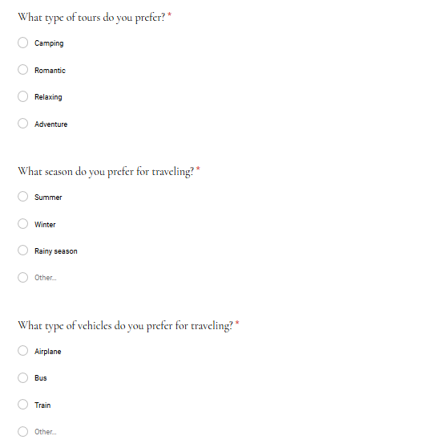
Questionnaires

Slide 12
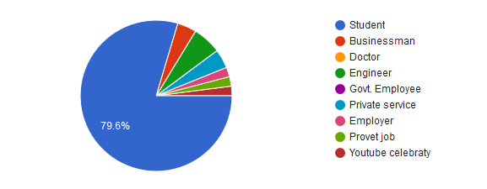
Survey Results
Count of Occupation

Slide 13
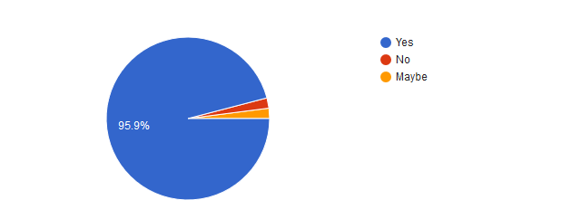
Survey Results(Continued)
Count the people who are interested to go for travelling

Slide 14
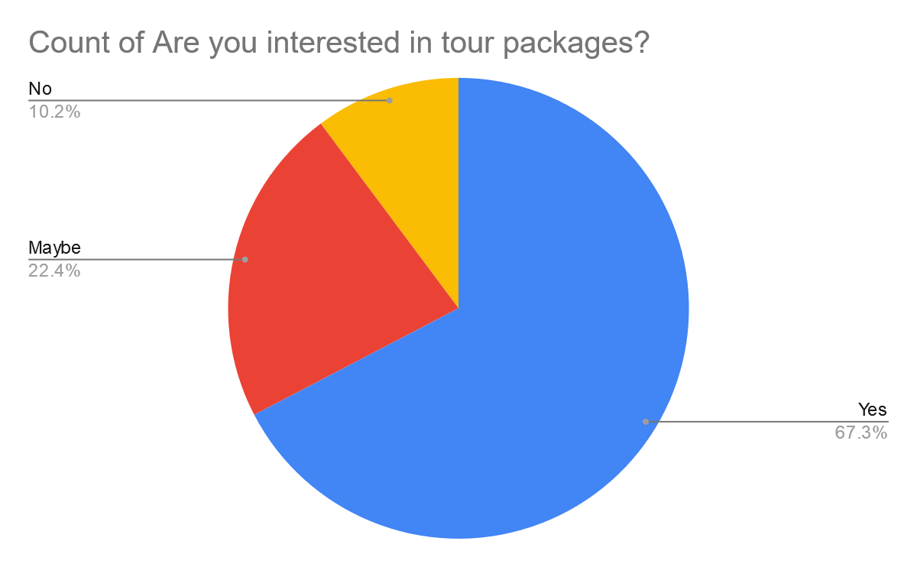
Survey Results(Continued)
Count the people who are interested in tour packages

Slide 15
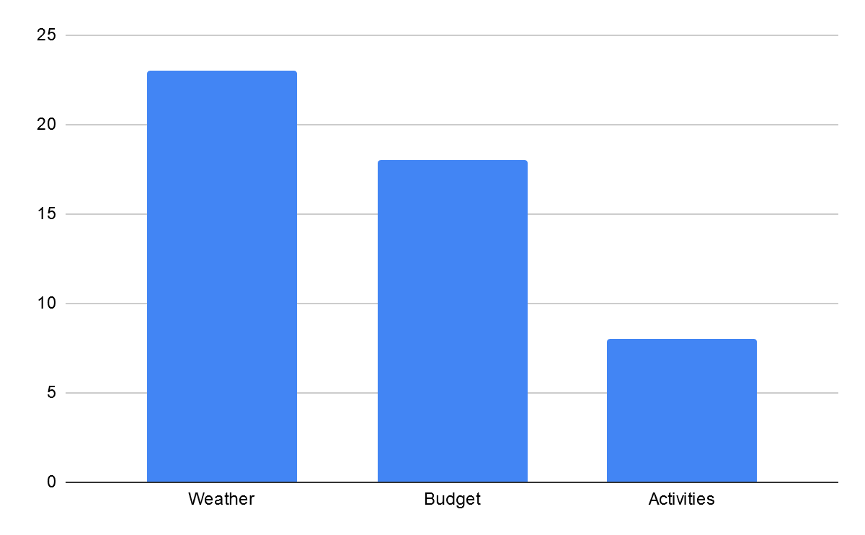
Survey Results(Continued)
Count of consideration before choosing a holiday destination

Slide 16
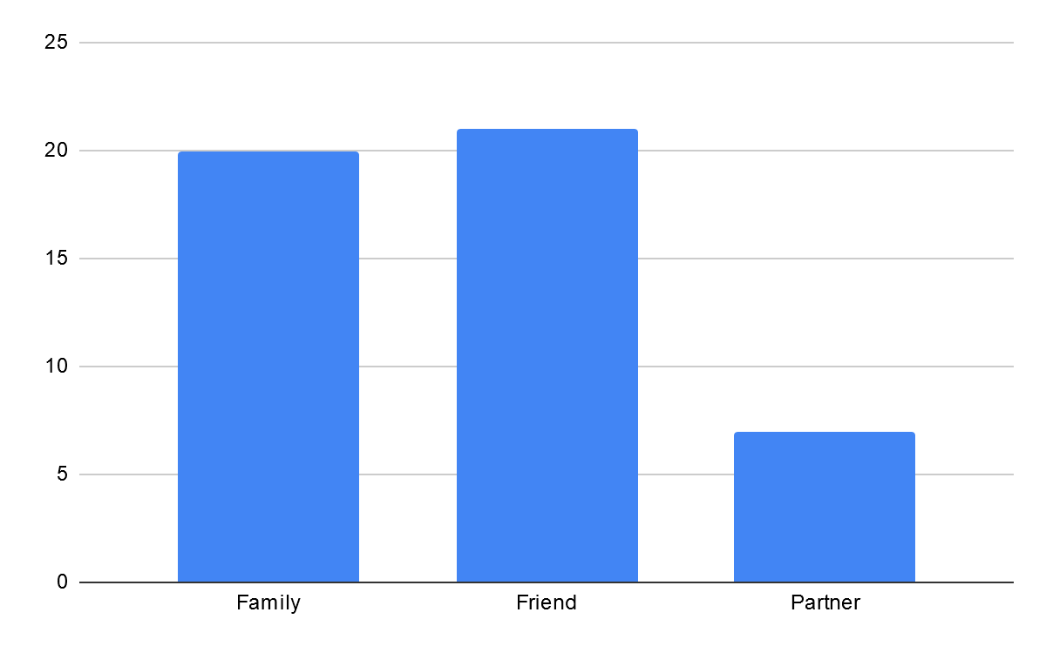
Survey Results(Continued)
Count the users who want to go on a tour with--

Slide 17
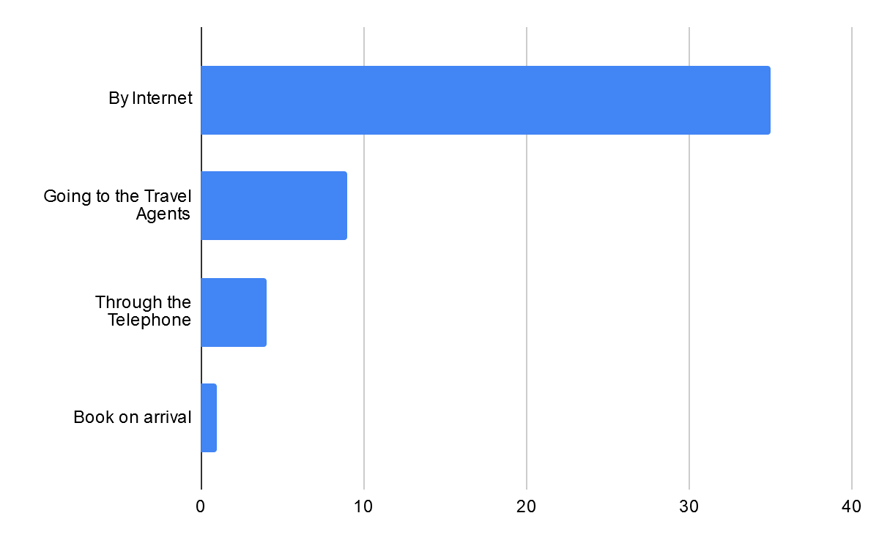
Survey Results(Continued)
Count of the users how they book their trips

Slide 18
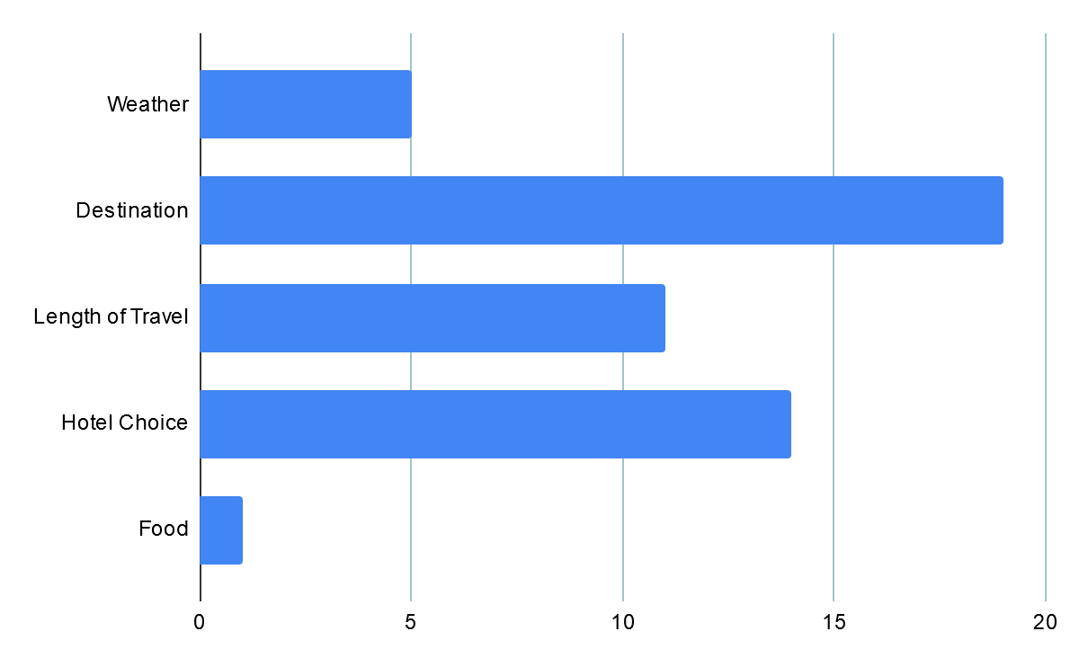
Survey Results(Continued)
Tour Plan Consideration

Slide 19
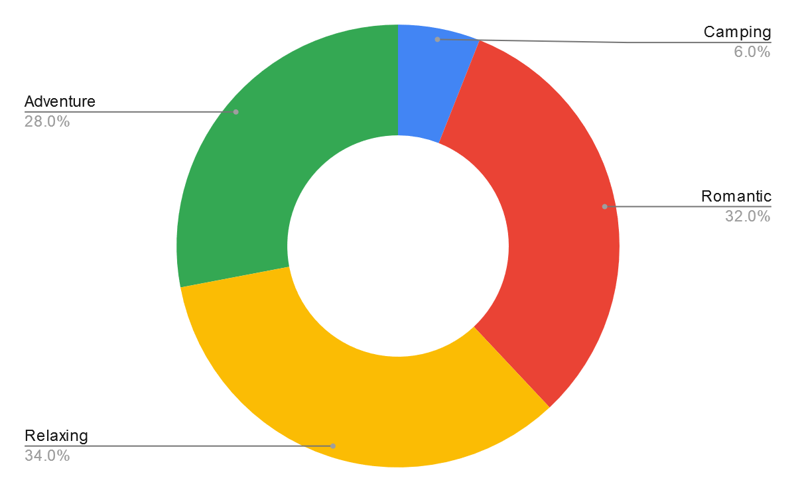
Survey Results(Continued)
Type of Tour Preference

Slide 20
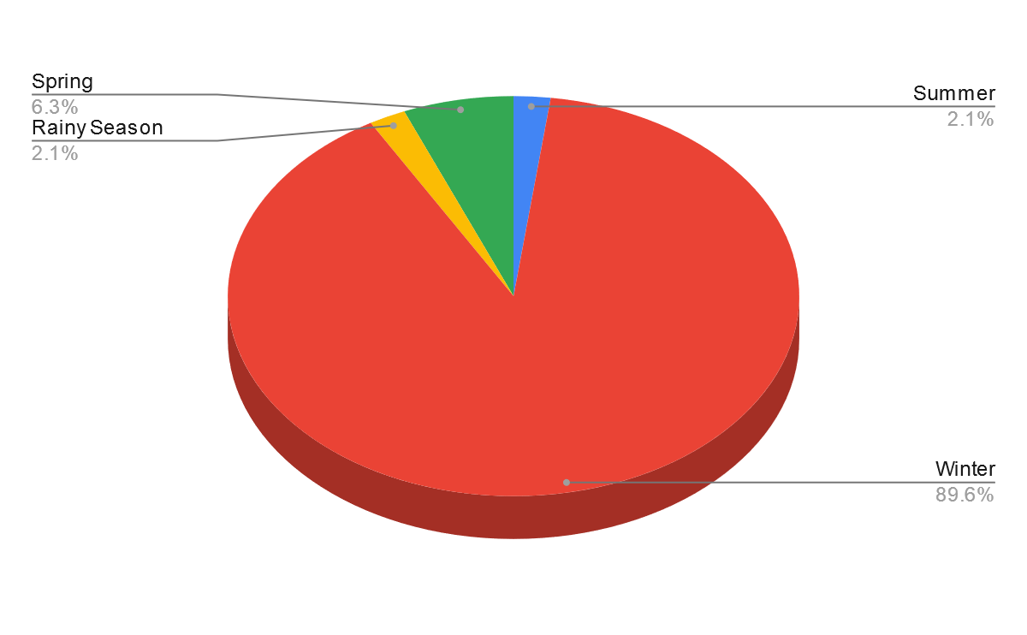
Survey Results(Continued)
Season Preference

Slide 21
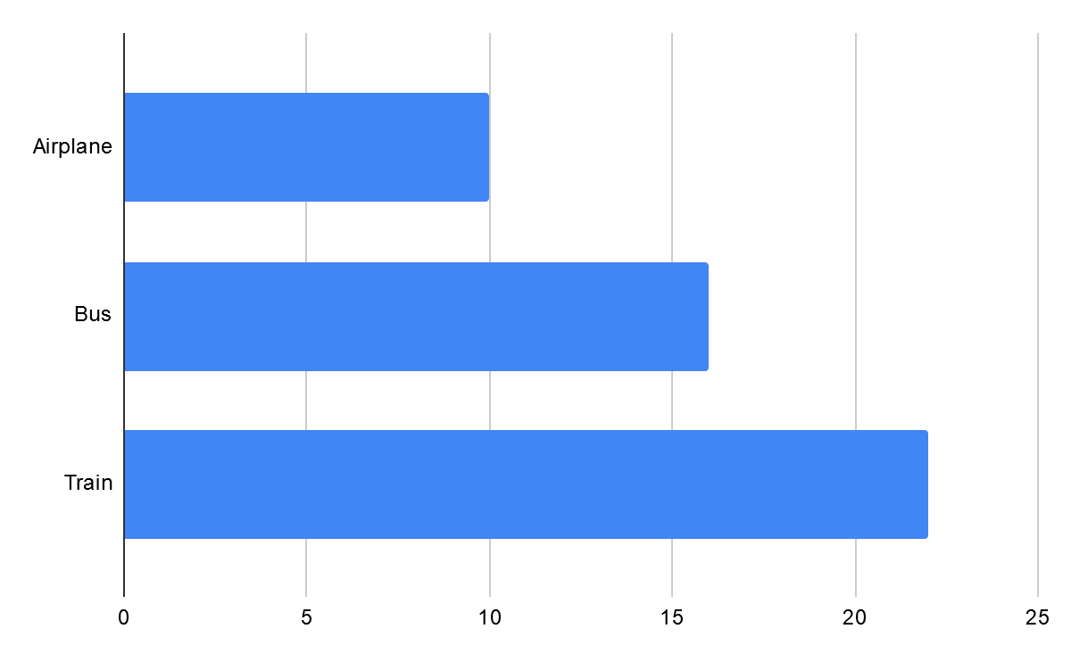
Survey Results(Continued)
Vehicle Preference

Slide 22
Investigation
95.5% people like to go on travel
67.3% people are interested in tour packages
Season Preference : Winter
Vehicle Preference : Train
Type of Tour Preference : Relaxing 34.0% , Romantic 32.0%
Book the trips : By Internet

Slide 23
Revised Requirement Analysis
Functional Requirement:
Users should be allowed to claim their travelling expenses related to their official visits.
System should support both domestic journey and international journey.
System should capture traveller name or id, destination, time period, purpose and some accounting info as basic data of visit.
There should be tracking the user who entered the travel data.

Slide 24
Revised Requirement Analysis
Non Functional Requirement:
All the UI should be unique and running both IE and Firefox browsers.
Supports many languages.
Reports are exported to different formats.
Evert caption should self explanation.
Valid user/ password.

